Slide 1
How to submit your results?
Presentation available at
goo.gl/Dvkb4B

Slide 2
Shiny App for submission
http://176.31.253.205/shiny/mediation-challenge/shiny-app/

Slide 3
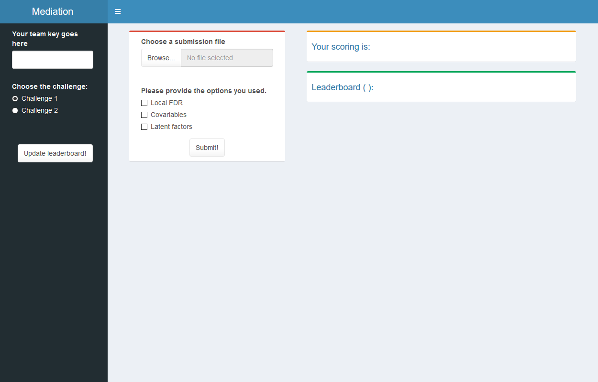

Slide 4


Get your KEY
Form a team (1 to 3 people)
Find a name for your team
Email with
The name of your team
The names of the people in the team
We will answer with your team key
Then copy and paste it in

Slide 5
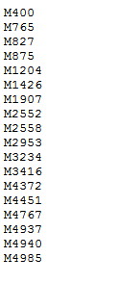

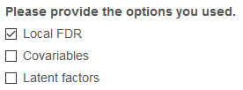


File of submission
File: one marker per line (use write in R)
Browse it
Provide the options you used
Submit (to the right challenge)

Slide 7




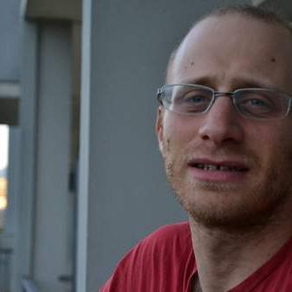
Questions?
Florian PRIVÉ
Keurcien LUU
Kevin CAYE
Bug in submission
Shiny
Server hosting Shiny app
R related to mediation
Other R questions
Michael BLUM
Olivier FRANÇOIS

